Slide 1
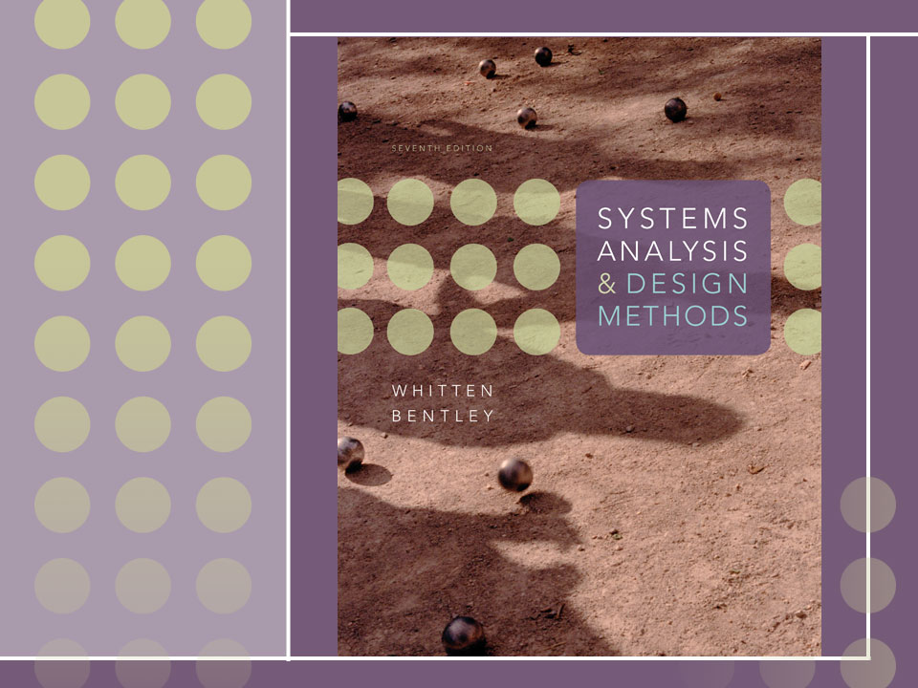
Chapter 11
Feasibility Analysis and the System Proposal

Slide 2
Objectives
Identify feasibility checkpoints in the systems life cycle.
Identify alternative system solutions.
Define and describe six types of feasibility and their respective criteria.
Perform various cost-benefit analyses using time-adjusted costs and benefits.
Write suitable system proposal reports for different audiences.
Plan for a formal presentation to system owners and users.

Slide 3
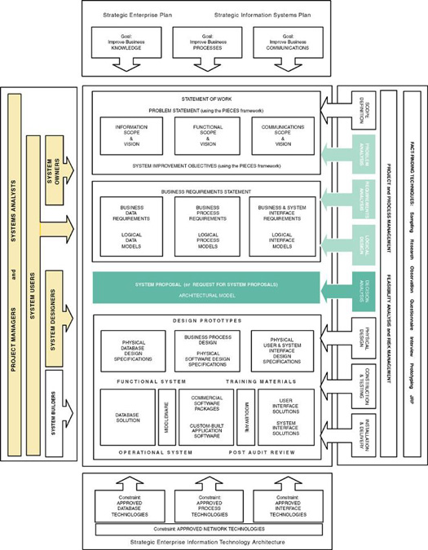

Slide 4
Feasibility Analysis
Feasibility – the measure of how beneficial or practical an information system will be to an organization.
Feasibility analysis – the process by which feasibility is measured.
Creeping Commitment – an approach to feasibility that proposes that feasibility should be measured throughout the life cycle.

Slide 5
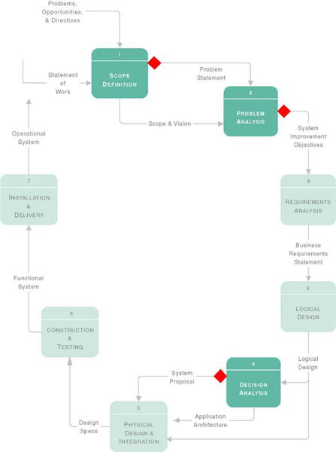
Feasibility Checkpoints During Systems Analysis

Slide 6
Six Tests For Feasibility
Operational feasibility – a measure of how well a solution meets the system requirements.
Cultural (or political) feasibility - a measure of how well a solution will be accepted in an organizational climate.
Technical feasibility – a measure of the practicality of a technical solution and the availability of technical resources and expertise.
Schedule feasibility – a measure of how reasonable the project timetable is.
Economic feasibility - a measure of the cost-effectiveness of a project or solution.
Legal feasibility - a measure of how well a solution can be implemented within existing legal/contractual obligations.

Slide 7
Operational Feasibility
How well proposed system solves the problems and takes advantage of opportunities identified during the scope definition and problem analysis phases
How well proposed system satisfies system requirements identified in the requirements analysis phase
Is the problem still worth solving?

Slide 8
Cultural (or political) feasibility
Does management support the system?
How do end users feel about their role in the system?
What end users may resist or not use the system? How can this be overcome?
How will the working environment change? Can users and management adapt to the change?

Slide 9
Technical feasibility
Is the proposed technology or solution practical?
Do we currently possess the necessary technology?
Do we possess the necessary technical expertise?

Slide 10
Schedule feasibility
Are specified deadlines mandatory or desirable?
Are mandatory deadlines realistic for proposed solution?

Slide 11
Economic feasibility
During Scope Definition
  Do the problems or opportunities warrant the cost of a detailed study and analysis of the current system?
During Problem Analysis
  After a detailed study of the current system
  Better estimates of development costs and benefits
During Decision Analysis
  Requirements now defined
  Development costs can be better estimated

Slide 12
Legal feasibility
Copyrights
Union contracts
Legal requirements for financial reporting
Antitrust laws
National data and work laws

Slide 13
Information System Costs
Development costs - one time costs that will not recur after the project has been completed.
  Personnel
  Computer usage
  Training
  Supply, duplication, and equipment
  Computer equipment and software
Operating costs - costs that recur throughout the lifetime of the system.
  Fixed costs — occur at regular intervals but at relatively fixed rates.
  Variable costs — occur in proportion to usage.

Slide 14
Information System Benefits
Tangible benefits are those that can be easily quantified.
Intangible benefits are those benefits believed to be difficult or impossible to quantify.
  Fewer processing errors
  Increased throughput
  Decreased response time
  Elimination of job steps
  Increased sales
  Reduced credit losses
  Reduced expenses

Slide 15
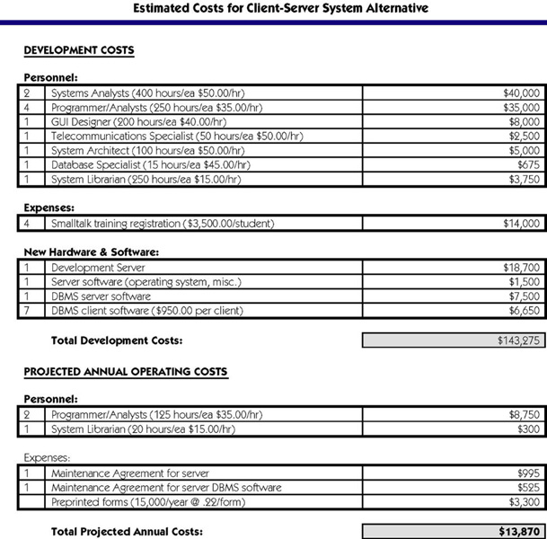
Costs for a Proposed Solution

Slide 16
Three Popular Techniques to Assess Economic Feasibility
Payback Analysis
Return On Investment
Net Present Value

Slide 17
Time Value of Money
Used with all three cost-effectiveness techniques.
Concept that recognizes that a dollar today is worth more than a dollar one year from now.
  Invest $100 at 2% for one year yields $102.
  So $100 today and $102 one year from today represent the same value.
  Given $20,000 benefit from information system two years from now and 10% return from other investments, means that benefit is worth $16,528 today.

Slide 18
Payback Analysis
Payback analysis – a technique for determining if and when an investment will pay for itself.
Payback period – the period of time that will lapse before accrued benefits overtake accrued and continuing costs.

Slide 19
Present Value Formula
Present value – the current value of a dollar at any time in the future.
PV_{n} = 1/(1 + i)^{n}
Where n is the number of years and i is discount rate
Discount rate – a percentage similar to interest rates that you earn on your savings.
  In most cases the discount rate for a business is the opportunity cost of being able to invest money in other projects or investments

Slide 20
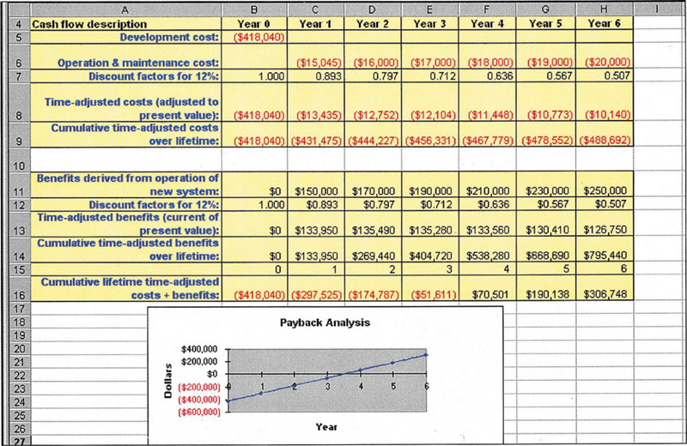
Payback Analysis for a Project

Slide 21
Return-on-Investment Analysis (ROI)
Return-on-Investment (ROA) analysis – a technique that compares the lifetime profitability of alternative solutions.
  The ROI for a solution or project is a percentage rate that measures the relationship between the amount the business gets back from an investment and the amount invested.
Lifetime ROI =
(estimated lifetime benefits – estimated lifetime costs) / estimated lifetime costs
Annual ROI = lifetime ROI / lifetime of the system

Slide 22
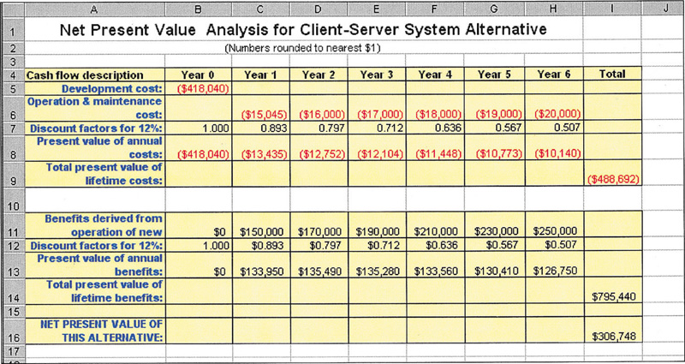
Net Present Value (NPV) Analysis
Net present value – analysis technique that compares annual discounted costs and benefits of alternative solutions.

Slide 23
Candidate Systems Matrix
 | Candidate 1 Name | Candidate 2 Name | Candidate 3 Name
Stakeholders
Knowledge
Processes
Communications
Candidate Systems Matrix – a tool used to document similarities and differences between candidate systems.
  Stakeholders - how system will interact with people and other systems.
  Knowledge - how data will be implemented, how inputs will be captured, how outputs will be generated.
  Processes - how processes will be built and implemented.
  Communications - how processes and data will be distributed.

Slide 24
Sample Candidate Systems Matrix
Characteristics | Candidate 1 | Candidate 2 | Candidate 3
Portion of System Computerized Brief description of that portion of the system that would be computerized in this candidate. | COTS package Platinum Plus from Entertainment Software Solutions would be purchased and customized to satisfy Member Services required functionality. | Member Services and warehouse operations in relation to order fulfillment. | Same as candidate 2.
Benefits Brief description of the business benefits that would be realized for this candidate. | This solution can be implemented quickly because it’s a purchased solution. | Fully supports user required business processes for SoundStage Inc. Plus more efficient interaction with member accounts. | Same as candidate 2.
Servers and Workstations A description of the servers and workstations needed to support this candidate. | Technically architecture dictates Pentium III, MS Windows 2000 class servers and workstations (clients). | Same as candidate 1. | Same as candidate 1.
Software Tools Needed Software tools needed to design and build the candidate (e.g., database management system, emulators, operating systems, languages, etc.). Not generally applicable if applications software packages are to be purchased. | MS Visual C++ and MS Access for customization of package to provide report writing and integration. | MS Visual Basic 5.0 System Architect 2001 Internet Explorer | MS Visual Basic 5.0 System Architect 2001 Internet Explorer

Slide 25
Sample Candidate Systems Matrix (cont.)
Characteristics | Candidate 1 | Candidate 2 | Candidate 3
Application Software A description of the software to be purchased, built, accessed, or some combination of these techniques. | Package solution | Custom Solution | Same as candidate 2.
Method of Data Processing Generally some combination of: on-line, batch, deferred batch, remote batch, and real-time. | Client/Server | Same as candidate 1. | Same as candidate 1.
Output Devices and Implications A description of output devices that would be used, special output requirements, (e.g., network, preprinted forms, etc.), and output considerations (e.g., timing constratints) | (2) HP4MV department laser printers (2) HP5SI LAN laser printers | (2) HP4MV department laser printers. (2) HP5SI LAN laser printers (1) PRINTRONIX bar-code printer (includes software & drivers) Web pages must be designed to VGA resolution. All internal screens will be designed for SVGA resolution. | Same as candidate 2.

Slide 26
Sample Candidate Systems Matrix (cont.)
Characteristics | Candidate 1 | Candidate 2 | Candidate 3
Input devices and Implications A description of input methods to be used, input devices (e.g., keyboard, mouse, etc.), special input requirements (e.g., new or revised forms from which data would be input), and input considerations (e.g., timing of actual inputs). | Keyboard & mouse. | Apple “Quick Take” digital camera and software (15) PSC Quickscan laser bar-code scanners (1) HP Scanjet 4C Flatbed Scanner Keyboard and mouse | Same as candidate 2.
Storage Devices and Implications Brief description of what data would be stored, what data would be accessed from existing stores, what storage media would be used, how much storage capacity would be needed, and how data would be organized. | MS SQL Server DBMS with 1000GB arrayed capability. | Same as candidate 1. | Same as candidate 1.

Slide 27
Feasibility Analysis Matrix
Feasibility Analysis Matrix – a tool used to rank candidate systems.
 | Weighting | Candidate 1 | Candidate 2 | Candidate 3
Description
Operational Feasibility
Cultural Feasibility
Technical Feasibility
Schedule Feasibility
Economic Feasibility
Legal Feasibility
Ranking

Slide 28
Sample Feasibility Analysis Matrix
 | Wt | Candidate 1 | Candidate 2 | Candidate 3
Description |  | Purchase commercial off-the-shelf package for member services. | Write new application in-house using new company standard VB.NET and SQL Server database | Rewrite current in-house application using Powerbuilder.
Operational feasibility | 15% | Supports only Member Services requirements. Current business process would have to be modified to take advantage of software functionality. Also there is concern about security in the system. Score: 60 | Fully supports user-required functionality. Score: 100 | Fully supports user-required functionality. Score: 100
Cultural Feasibility | 15% | Possible user resistance to non-standard user interface of proposed purchased package. Score: 70 | No foreseeable problems. Score: 100 | No foreseeable problems. Score: 100

Slide 29
Sample Feasibility Analysis Matrix (cont.)
 | Wt | Candidate 1 | Candidate 2 | Candidate 3
Technical feasibility | 20% | Current production release of Platinum Plus package is version 1.0 and has been on the market for only 6 weeks. Maturity of product is a risk, and company charges and additional monthly fee for technical support. Required to hire or train Java J2EE expertise to perform modifications for integration requirements. Score: 50 | Solution requires writing application in VB .NET. Although current technical staff has only Powerbuilder experience, it should be relatively easy to find programmers with VB .NET experience. Score: 95 | Although current technical staff is comfortable with Powerbuilder, management is concerned about acquisition of Powerbuilder by Sybase Inc. MS SQL Server is the current company standard for database, which competes with Sybase DBMS. We have no guarantee that future versions of Powerbuilder will "play well" with our current version of SQL Server. Score: 60

Slide 30
Sample Feasibility Analysis Matrix (cont.)
 | Wt | Candidate 1 | Candidate 2 | Candidate 3
Economic feasibility Cost to develop: Payback (discounted): Net present value: Detailed calculations: | 30% | Approx. $350.000 Approx. 4.5 years Approx. $210,000 See Attachment A Score: 60 | Approx. $418.000 Approx. 3.5 years Approx. $307,000 See Attachment A Score: 85 | Approx. $400.000 Approx. 3.3 years Approx. $325,000 See Attachment A Score: 90

Slide 31
Sample Feasibility Analysis Matrix (cont.)
 | Wt | Candidate 1 | Candidate 2 | Candidate 3
Schedule feasibility | 10% | Less than 3 months Score: 95 | 9-12 months Score: 80 | 9 months Score: 85
Legal feasibility | 10% | No foreseeable problems Score: 100 | No foreseeable problems Score: 100 | No foreseeable problems Score: 100
Weighted score | 100% | 67 | 92.5 | 87.5

Slide 32
The System Proposal
System proposal – a report or presentation of a recommended solution.
  Usually formal written report or oral presentation
  Intended for system owners and users

Slide 33
Length of the Written Report
To Executive-level managers - one or two pages
To Middle-level managers - three to five pages
To Supervisory-level managers - less than 10 pages
To clerk-level personnel - less than 50 pages.

Slide 34
Formats for Written Reports
factual format - traditional and best suited to readers interested in facts and details as well as conclusions.
administrative format - modern, result-oriented format preferred by managers and executives.
Factual Format | Administrative Format
I. Introduction | I. Introduction
II. Methods and procedures | II. Conclusions and recommendations
III. Facts and details | III. Summary and discussion of facts and details
IV. Discussion and analysis of facts and details | IV. Methods and procedures
V. Recommendations | V. Final conclusion
VI. Conclusion | VI. Appendixes with facts and details

Slide 35
Organization of the Written Report
Primary elements present the actual information that the report is intended to convey.
Secondary elements package the report so the reader can easily identify the report and its primary elements.

Slide 36
Secondary Elements for a
Written Report
Letter of transmittal
Title page
Table of contents
List of figures, illustrations, and tables
Abstract or executive summary
  (The primary elements--the body of the report, in either the factual or administrative format--are presented in this portion of the report.)
Appendices

Slide 37
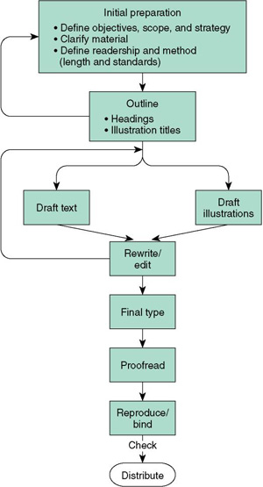
Writing the Report
Paragraphs should convey a single idea.
Sentences should not be too complex.
Write in active voice.
Eliminate jargon, big words, and deadwood.

Slide 38
System Proposal – formal presentations
Formal presentation – a special meeting used to sell new ideas and gain approval for new systems. They may also be used for any of these purposes:
  Sell new system
  Sell new ideas
  Head off criticism
  Address concerns
  Verify conclusions
  Clarify facts
  Report progress

Slide 39
Typical Outline and Time Allocation for an Oral Presentation
I. Introduction (one-sixth of total time available)
  A. Problem statement
  B. Work completed to date
II. Part of the presentation (two-thirds of total time available)
  A. Summary of existing problems and limitations
  B. Summary description of the proposed system
  C. Feasibility analysis
  D. Proposed schedule to complete project
III. Questions and concerns from the audience (time here is not to be included in the time allotted for presentation and conclusion; it is determined by those asking the questions and voicing their concerns)
IV. Conclusion (one-sixth of total time available)
  A. Summary of proposal
  B. Call to action (request for whatever authority you require to continue systems development)

Slide 40
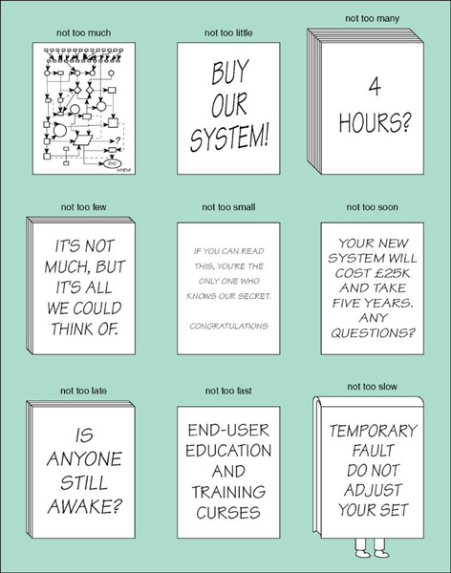
Guidelines for Visual Aids
Source: Copyright Keith London

Slide 41
Conducting the Formal Presentation
Dress professionally.
Avoid using the "I" word when making the presentation.
Maintain eye contact with the group and keep an air of confidence.
Be aware of your own mannerisms.

Slide 42
When Answering Questions
Always answer a question seriously, even if you think it is a silly question.
Answer both the individual who asked the question and the entire audience.
Summarize your answers.
Limit the amount of time you spend answering any one question.
Be honest.

